Slide 1
Back to School 2019
Коротаева Светлана Викторовна

Slide 2
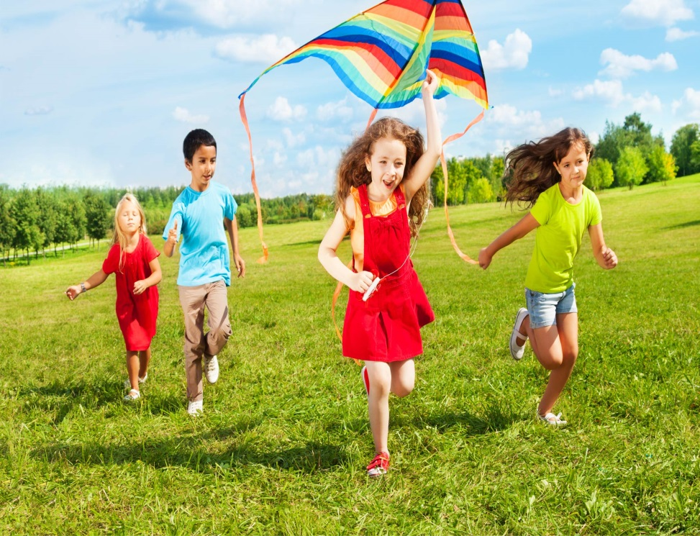
Write
Three words beginning with “b”(you liked during your summer holidays)
Three words beginning with “s”(children liked)
Three things to eat
Three things to wear
Three family members

Slide 3
Answer the questions :
Do you always look forward to your summer holidays?
What do you usually do if you stay at home in summer?
Are you fond of travelling?
What countries would you like to visit?
Have you ever been to the country?
What did you do there?
Do you like camping holiday?
What do you usually do on the sea shore?
Are you fond of lying in the sun or swimming ?
What do you enjoy doing in the evening?
What is your idea of an ideal holiday?

Slide 4
The five-pointed star
name
date
person
number
place
Film or book

